Slide 1

Computer Vision in Python Day 2, Part 3/4
Matthieu De Mari

Slide 2
About this lecture
What are videos and how can they be represented as a sequence of image frames?
What are typical uses of video processing models and why are image models alone insufficient to process videos?
What are sequential models and recurrent neural networks?
What are RNN models? LSTM models? GRU models?
How to combine RNNs and CNNs to process images?
(If time allows, what are transformers?)
(And, if time allows, how to combine transformers and CNNs for video processing?)

Slide 3
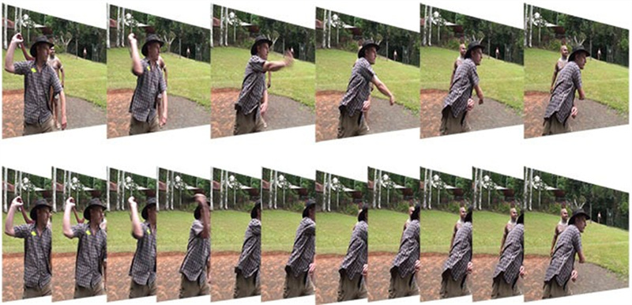
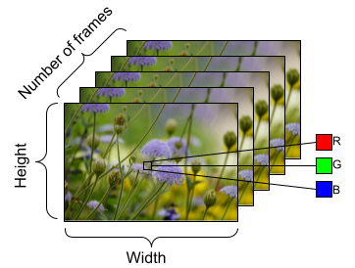
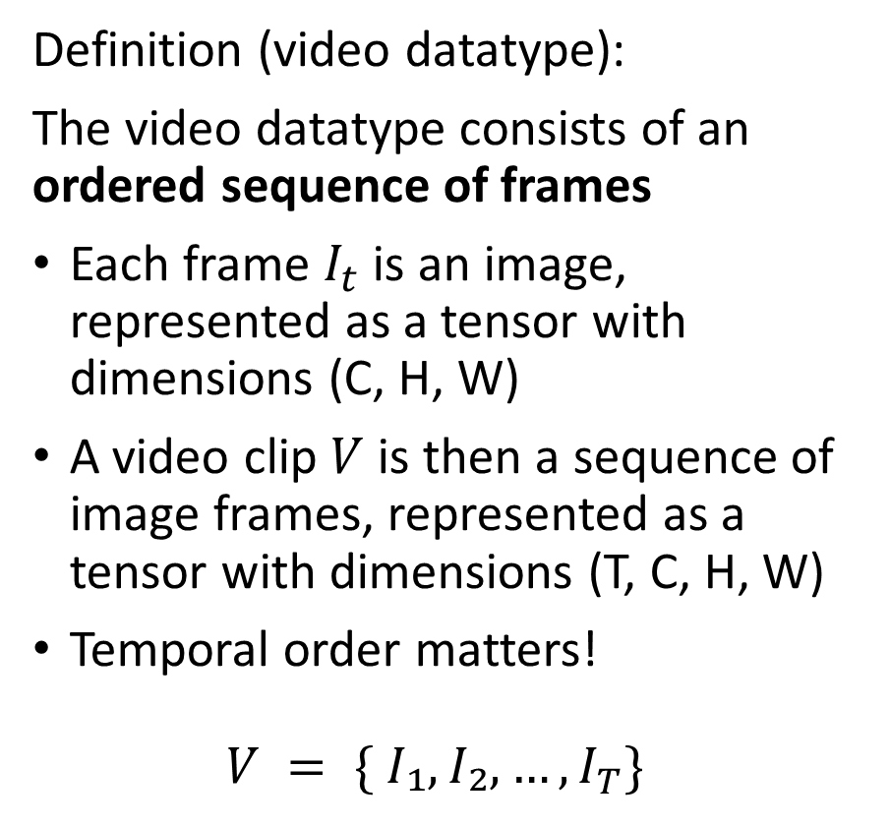
What is a video, mathematically?
Definition (video datatype):
The video datatype consists of an ordered sequence of frames
Each frame $I_{t}$ is an image, represented as a tensor with dimensions (C, H, W)
A video clip $V$ is then a sequence of image frames, represented as a tensor with dimensions (T, C, H, W)
Temporal order matters! $V = \{ I₁, I₂, …, I_{T}\}$

Slide 4
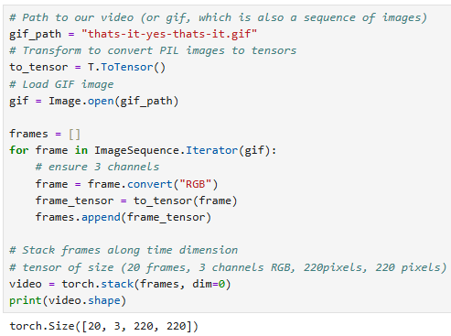
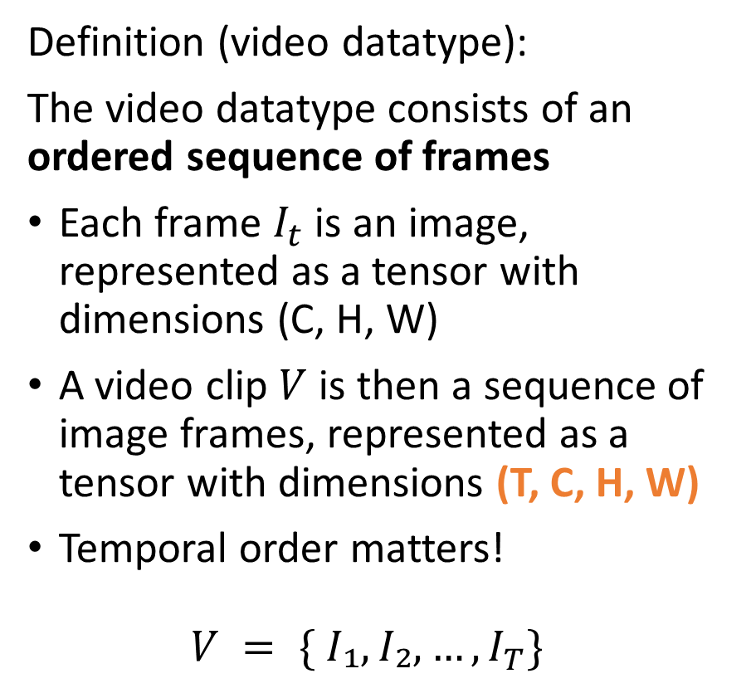
What is a video, mathematically?
Definition (video datatype):
The video datatype consists of an ordered sequence of frames
Each frame $I_{t}$ is an image, represented as a tensor with dimensions (C, H, W)
A video clip $V$ is then a sequence of image frames, represented as a tensor with dimensions (T, C, H, W)
Temporal order matters! $V = \{ I₁, I₂, …, I_{T}\}$

Slide 5
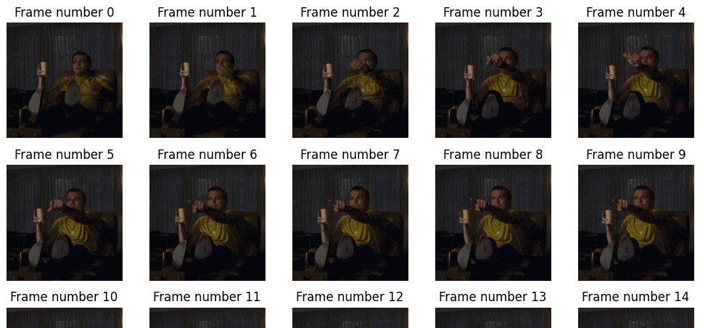
What is a video, mathematically?
Definition (video datatype):
The video datatype consists of an ordered sequence of frames
Each frame $I_{t}$ is an image, represented as a tensor with dimensions (C, H, W)
A video clip $V$ is then a sequence of image frames, represented as a tensor with dimensions (T, C, H, W)
Temporal order matters! $V = \{ I₁, I₂, …, I_{T}\}$

Slide 6
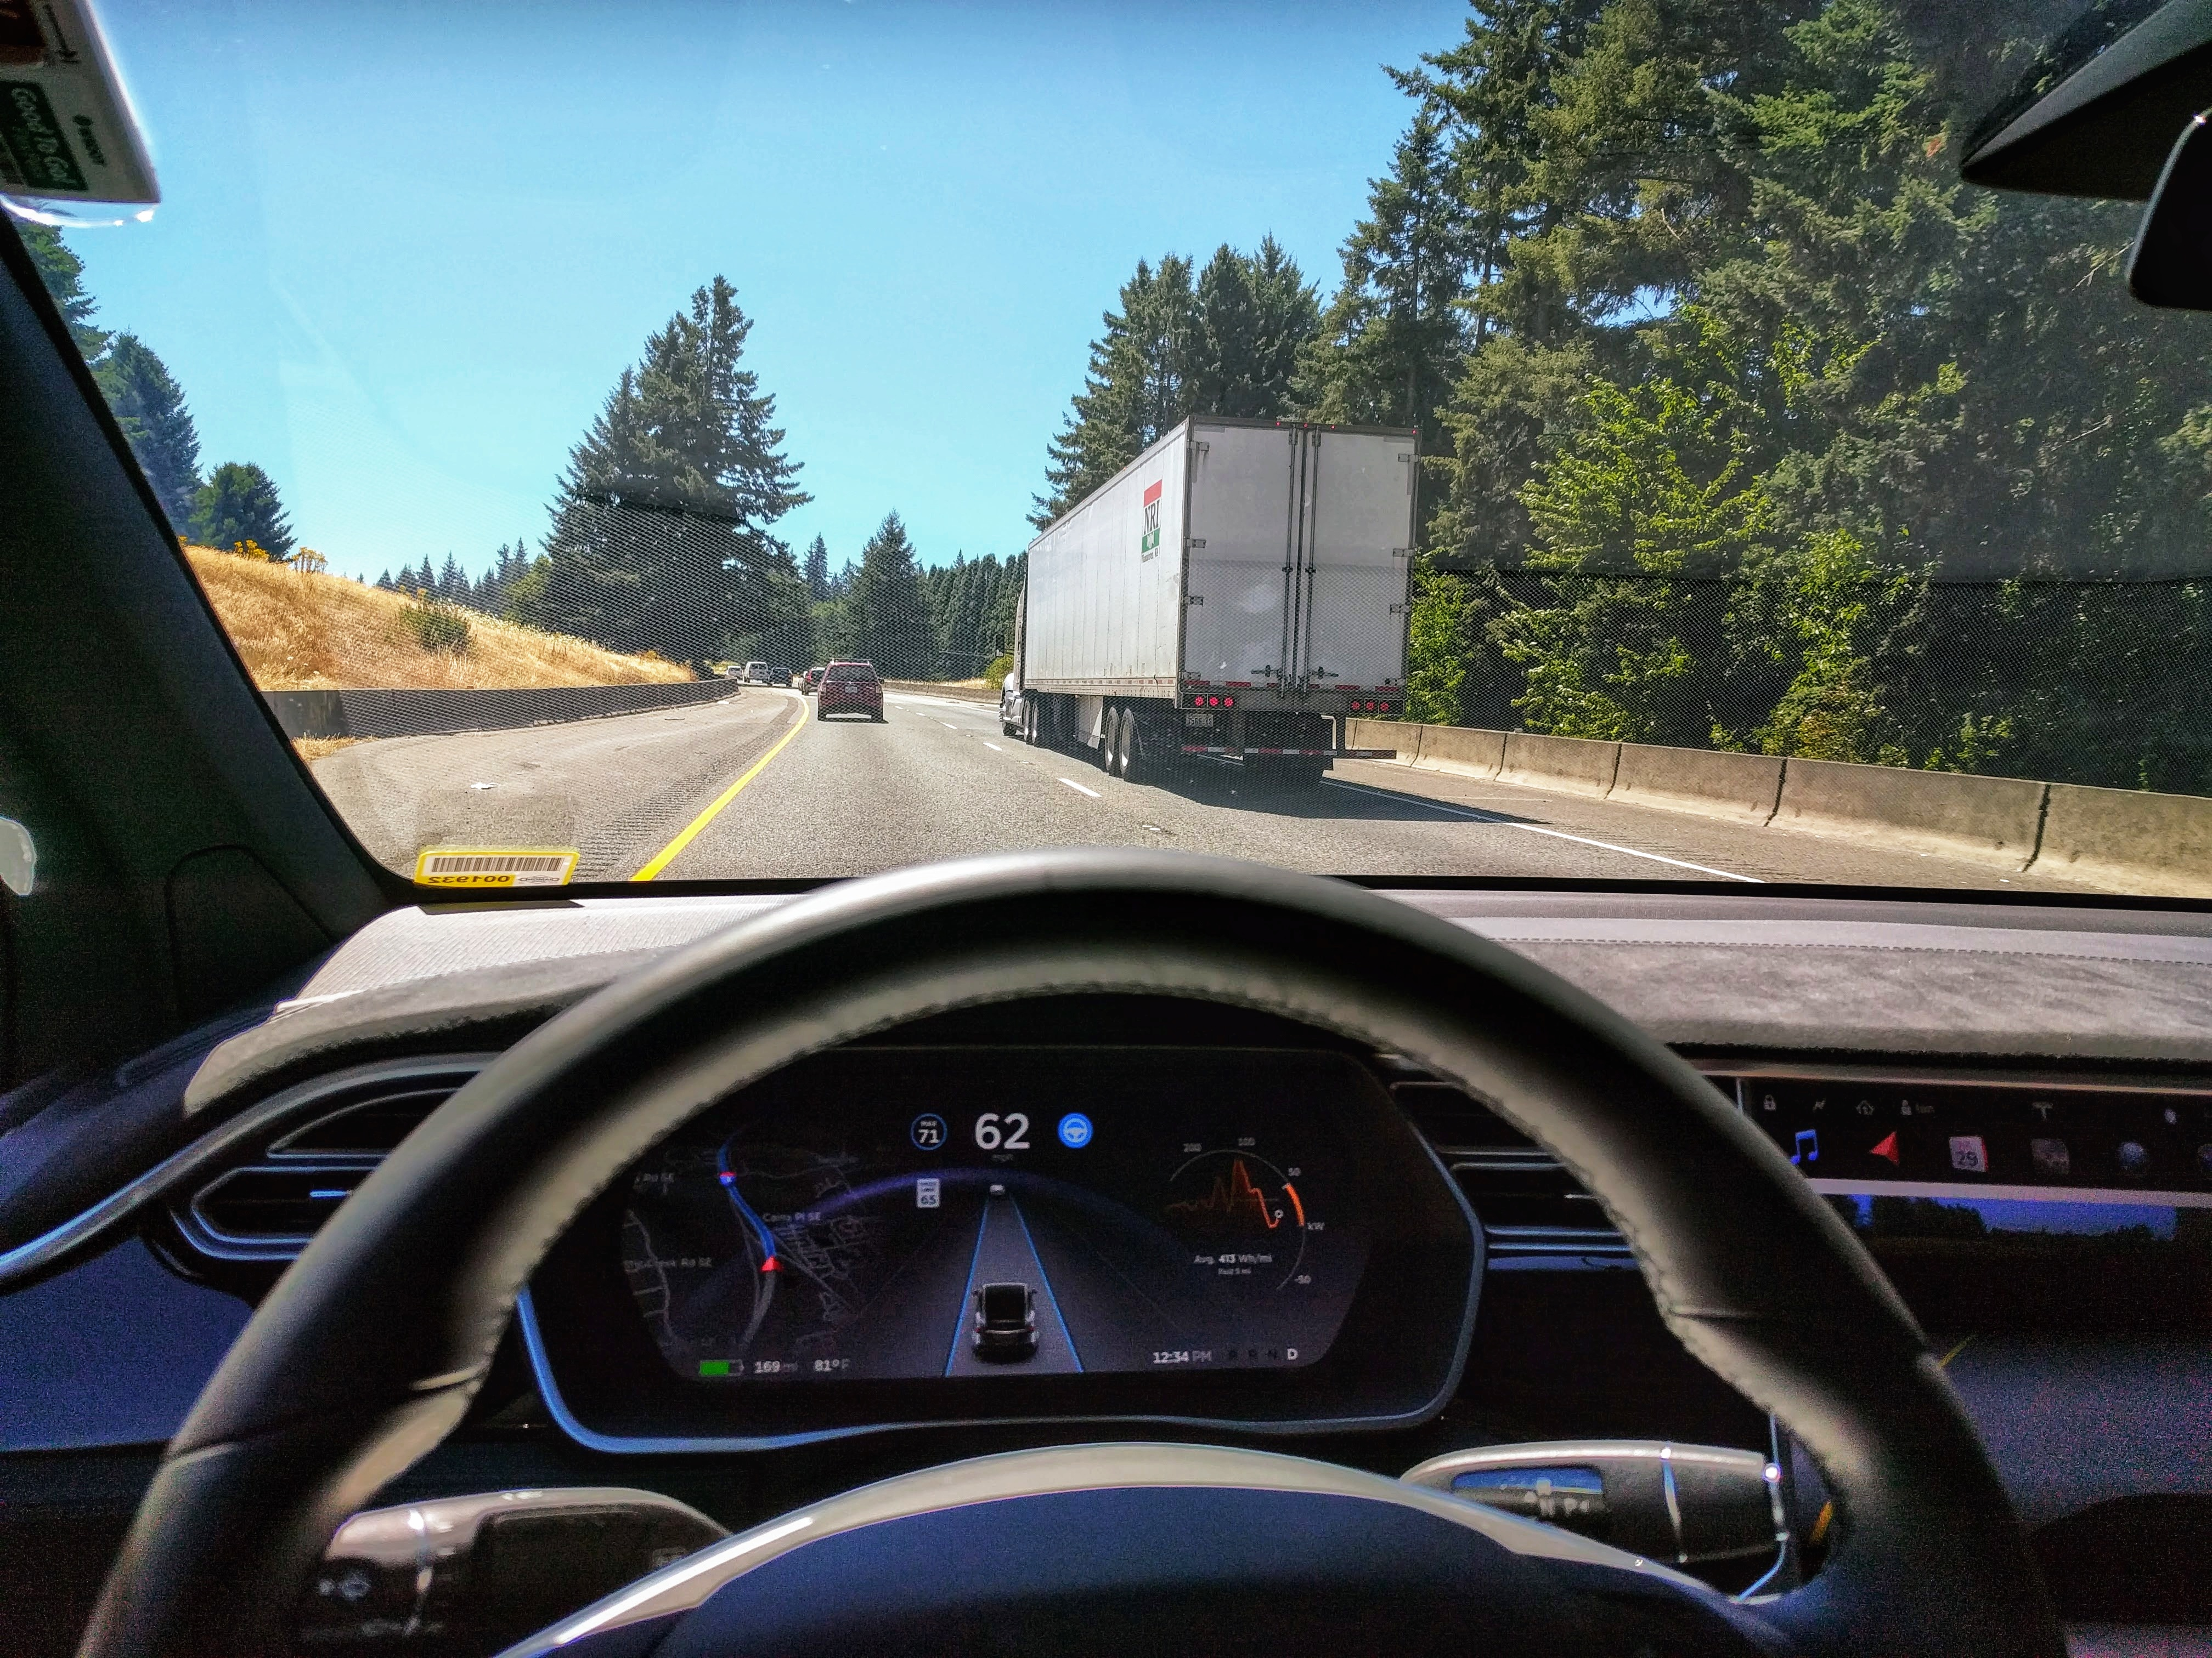
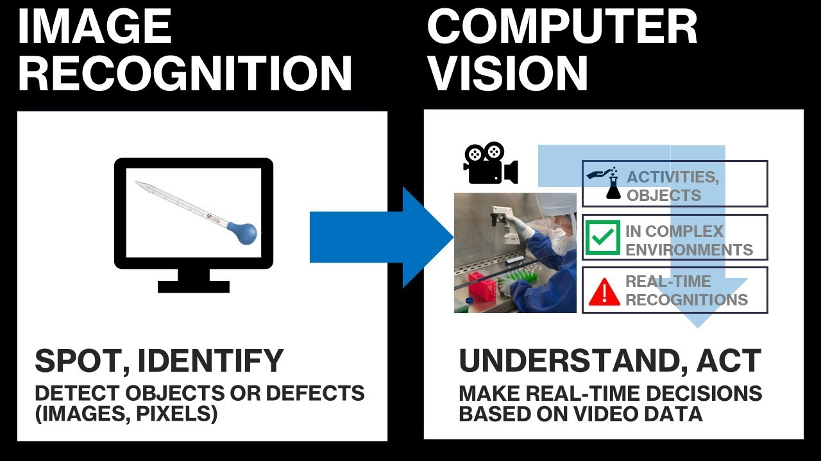
From images to videos
Key difference between image processing and video processing.
Performing image recognition boiled down to recognizing what is in the image.
Video recognition takes it one step further as it requires to recognize what is happening over time.
Far more complex task!

Slide 7
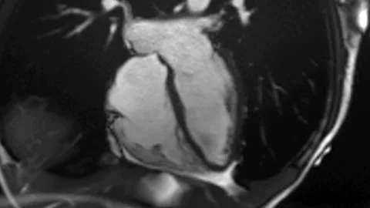
Applications
Self driving cars
Is there a pedestrian in the picture? (image recognition)
Is the pedestrian waiting or is he about to cross the street? (video processing)
Medical imaging
Is there cancer? Where are the cancer cells in the image? (image recognition)
Is the heart beating incorrectly? (video processing)

Slide 8
The simplest video baseline
Frame $I_{1}$
Frame 𝐼_1
CNN
Output for $I_{1}$
Output for 𝐼_1
A simple baseline for video understanding
Treat a video as a set of frames
Apply a CNN to each frame independently
Aggregate frame-level information after each image has been processed
Predict one label per video
Frame $I_{2}$
Frame 𝐼_2
CNN
Output for $I_{2}$
Output for 𝐼_2
Final Decision
…
Frame $I_{T}$
Frame 𝐼_𝑇
CNN
Output for $I_{T}$
Output for 𝐼_𝑇

Slide 9
The simplest video baseline
Frame $I_{1}$
Frame 𝐼_1
CNN
Output for $I_{1}$
Output for 𝐼_1
Strengths
Appearance-based reasoning
Simple and efficient
Strong baseline
Limitations
Treats images independently
No motion modeling
No temporal order or sequence
Cannot distinguish reversed actions or shuffled images
Frame $I_{2}$
Frame 𝐼_2
CNN
Output for $I_{2}$
Output for 𝐼_2
Final Decision
…
Frame $I_{T}$
Frame 𝐼_𝑇
CNN
Output for $I_{T}$
Output for 𝐼_𝑇

Slide 10
What’s missing?
Frame $I_{1}$
Frame 𝐼_1
CNN
Output for $I_{1}$
Output for 𝐼_1
Correctly processing videos requires to understand:
Motion direction
Temporal causality
Long-term dependencies
In other words: “How do we model order to better understand what is happening in the sequence of images?”
Frame $I_{2}$
Frame 𝐼_2
CNN
Output for $I_{2}$
Output for 𝐼_2
Final Decision
…
Frame $I_{T}$
Frame 𝐼_𝑇
CNN
Output for $I_{T}$
Output for 𝐼_𝑇

Slide 11
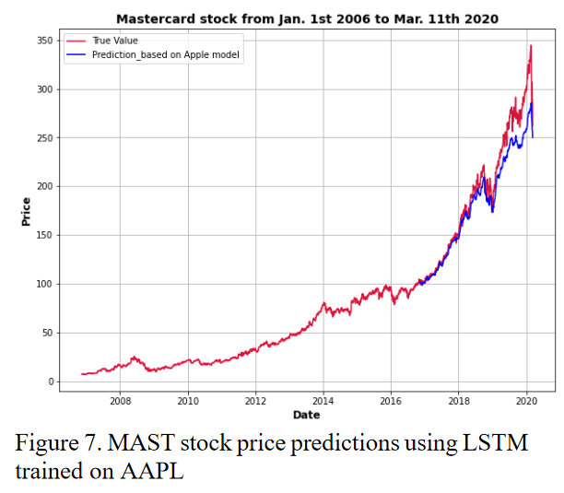
Quick interlude: about time series
Definition (time series dataset):
A time series dataset is a sequence of data points that are collected over time, typically at regular intervals.
Time series data can be used to study how a particular variable changes over time, with many applications as stock prices, weather patterns, etc.

Slide 12
Quick interlude: about time series
Definition (time series dataset):
A time series dataset is a sequence of data points that are collected over time, typically at regular intervals.
Time series data can be used to study how a particular variable changes over time, with many applications as stock prices, weather patterns, etc.
Time series have structure (somewhat similar to videos).
This means that shuffling the data points in a time series has a destructive effect on your dataset, just like shuffling pixels in an image or frames in a video!
They are usually ordered chronologically, with each data point representing the value of a variable at a specific time.

Slide 13
Quick interlude: about time series
Time series are often represented as tensors of size (T, V).
With T being the number of time steps (or data points in the time series).
And values at a given time are assembled in a vector of size V, often set to just 1.
These time series tensors can be seen as the numerical “cousin” of video tensors.

Slide 14
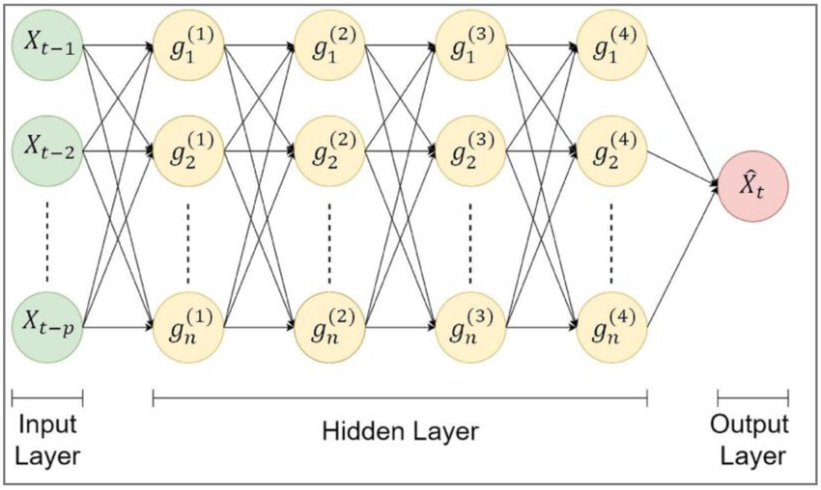
Why standard NNs fail on time series
Why linear NN are insufficient
Linear neural networks assume fixed-size input
They have no notion of order
No memory of previous values
Shuffle timesteps → Same input to an MLP (same idea as shuffling pixels in an image or frames in a video, earlier!)

Slide 15
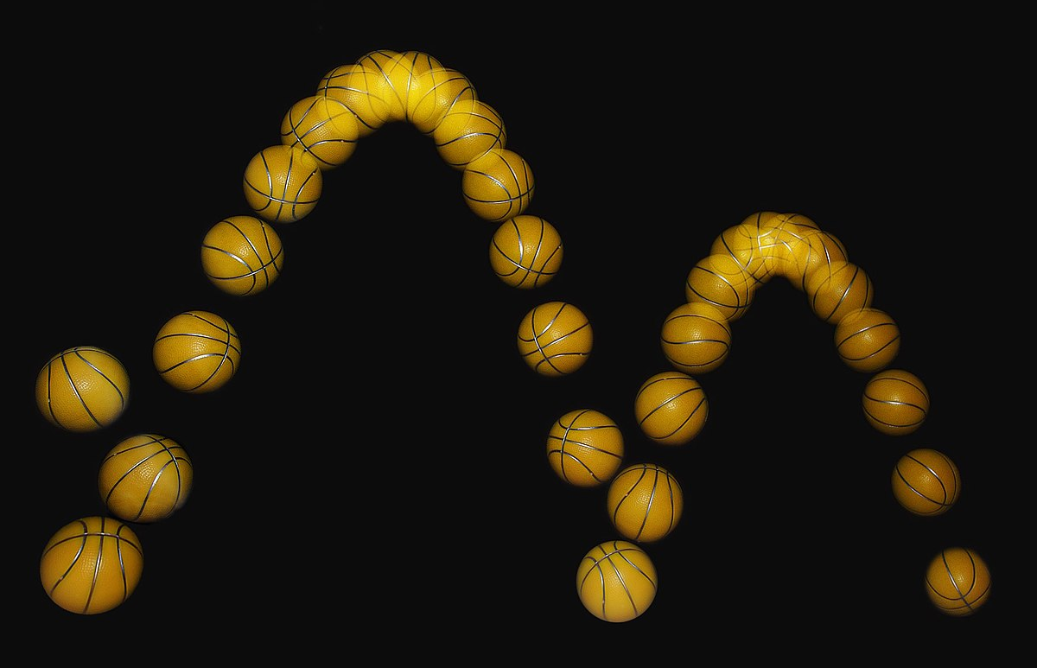
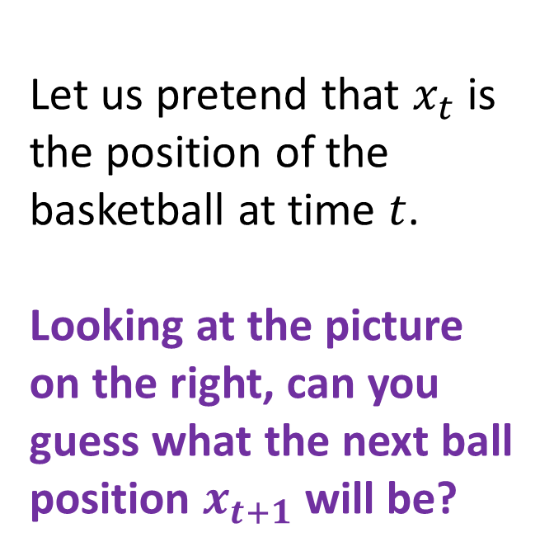
A visual example for the need of “memory”
Let us pretend that $x_{t}$ is the position of the basketball at time $t$.
Looking at the picture on the right, can you guess what the next ball position $x_{t+1}$ will be?
????

Slide 16
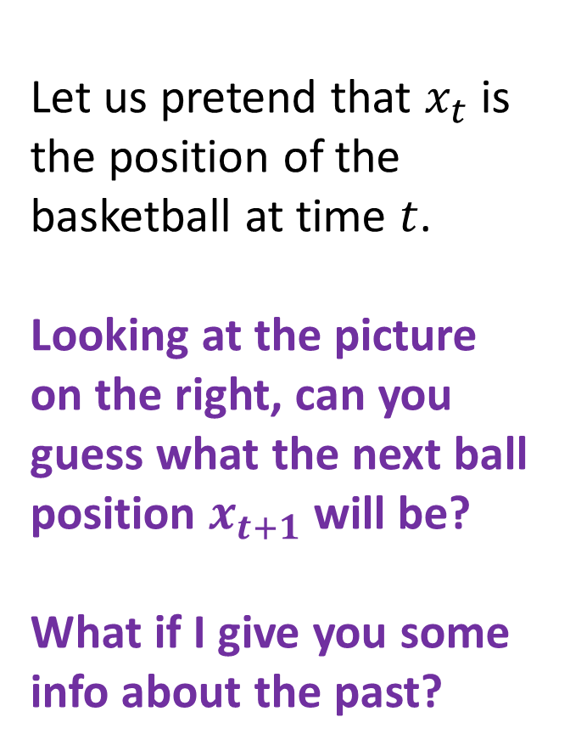
A visual example for the need of “memory”
Let us pretend that $x_{t}$ is the position of the basketball at time $t$.
Looking at the picture on the right, can you guess what the next ball position $x_{t+1}$ will be?
What if I give you some info about the past?
????

Slide 17
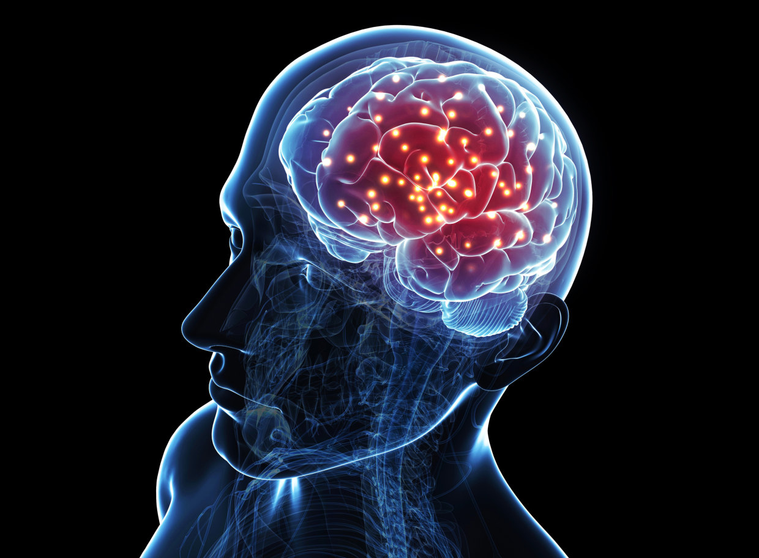
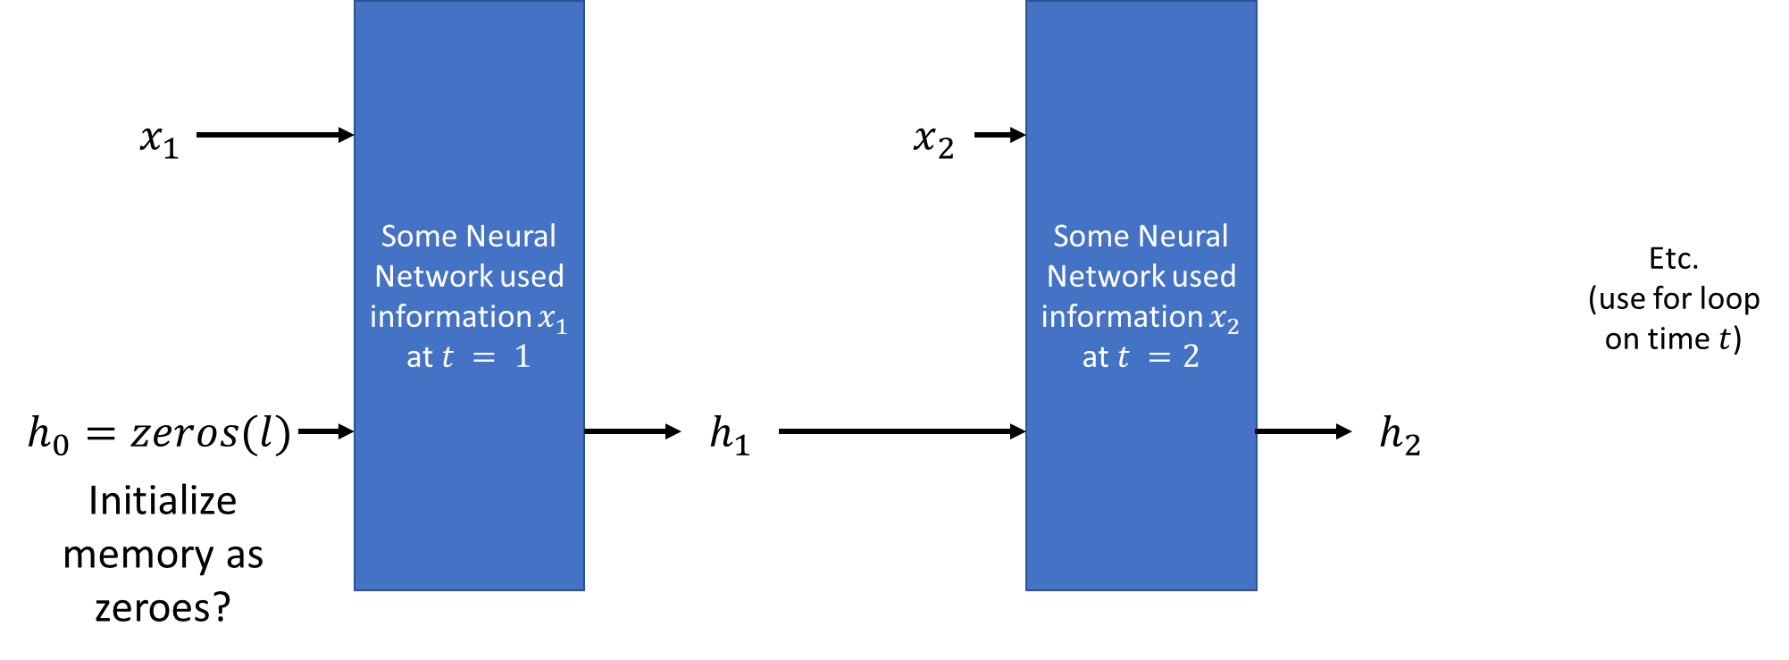
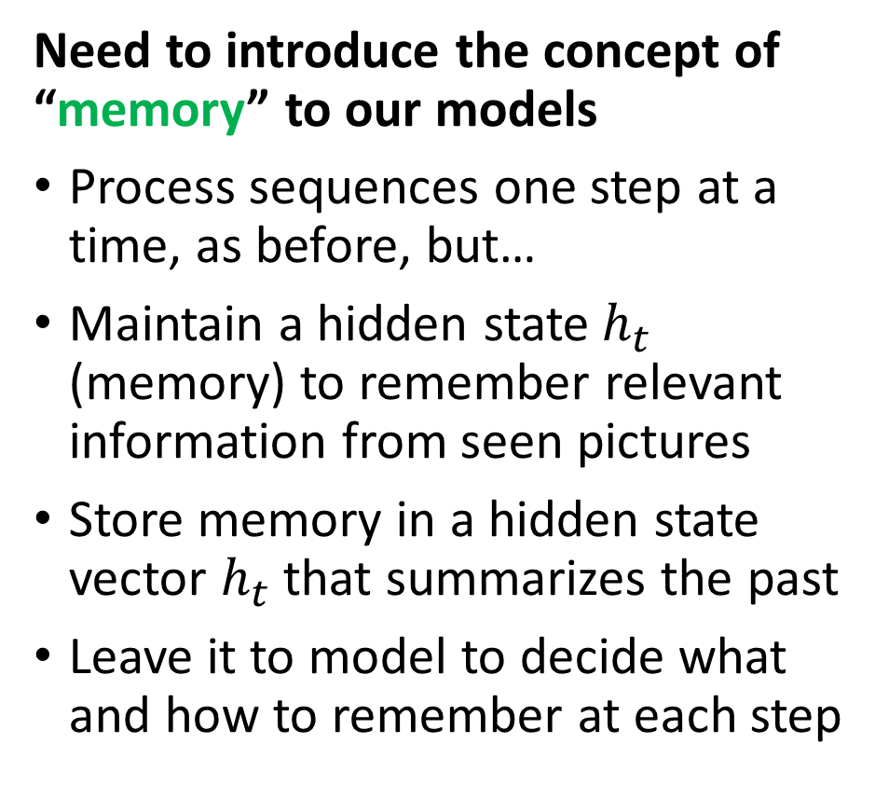
The need for memory and RNNs
Need to introduce the concept of “memory” to our models
Process sequences one step at a time, as before, but…
Maintain a hidden state$h_{t}$ (memory) to remember relevant information from seen pictures
Store memory in a hidden state vector $h_{t}$that summarizes the past
Leave it to model to decide what and how to remember at each step

Slide 18


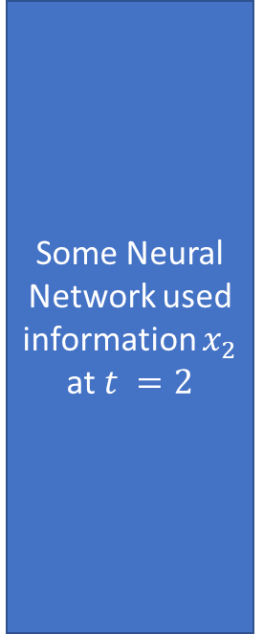
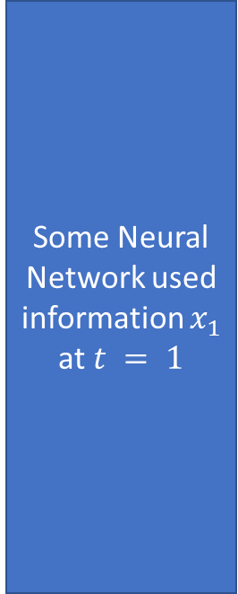

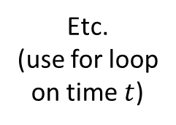


The need for memory and RNNs
Some Neural Network used information $x_{1}$
at $t = 1$
Some Neural Network used information $x_{2}$
at $t =2$
$$x_{1}$$
$$x_{2}$$
Etc.
(use for loop on time $t$)
$$h_{0}=zeros(l)$$
$$h_{1}$$
$$h_{2}$$
Initialize memory as zeroes?

Slide 19
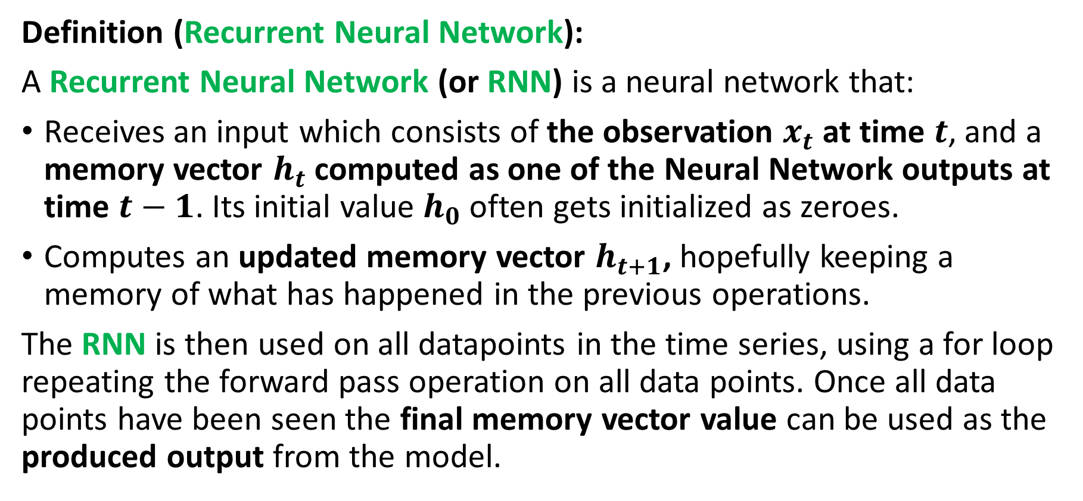
Defining a Recurrent Neural Network (RNN)
Definition (Recurrent Neural Network):
A Recurrent Neural Network (or RNN) is a neural network that:
Receives an input which consists of the observation $x_{t}$ at time $t$, and a memory vector $h_{t}$ computed as one of the Neural Network outputs at time $t−1$. Its initial value $h_{0}$ often gets initialized as zeroes.
Computes an updated memory vector $h_{t+1}$, hopefully keeping a memory of what has happened in the previous operations.
The RNN is then used on all datapoints in the time series, using a for loop repeating the forward pass operation on all data points. Once all data points have been seen the final memory vector value can be used as the produced output from the model.

Slide 20
Want to learn more about RNNs?
Recurrent Neural Networks are typically used on numerical time series data (think weather, finance, etc.)
They are also used a lot in Natural Language Processing: A sentence can be seen as a time series of words!
Their intuition, and implementation logic is out-of-scope for this course.
(But if curious, bonus slides!)

Slide 21
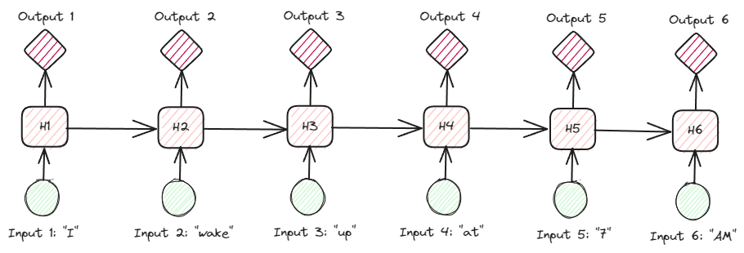
Want to learn more about RNNs?
Recurrent Neural Networks are typically used on numerical time series data (think weather, finance, etc.)
They are also used a lot in Natural Language Processing: A sentence can be seen as a time series of words!
Their intuition, and implementation logic is out-of-scope for this course.
(But if curious, bonus slides!)

Slide 22
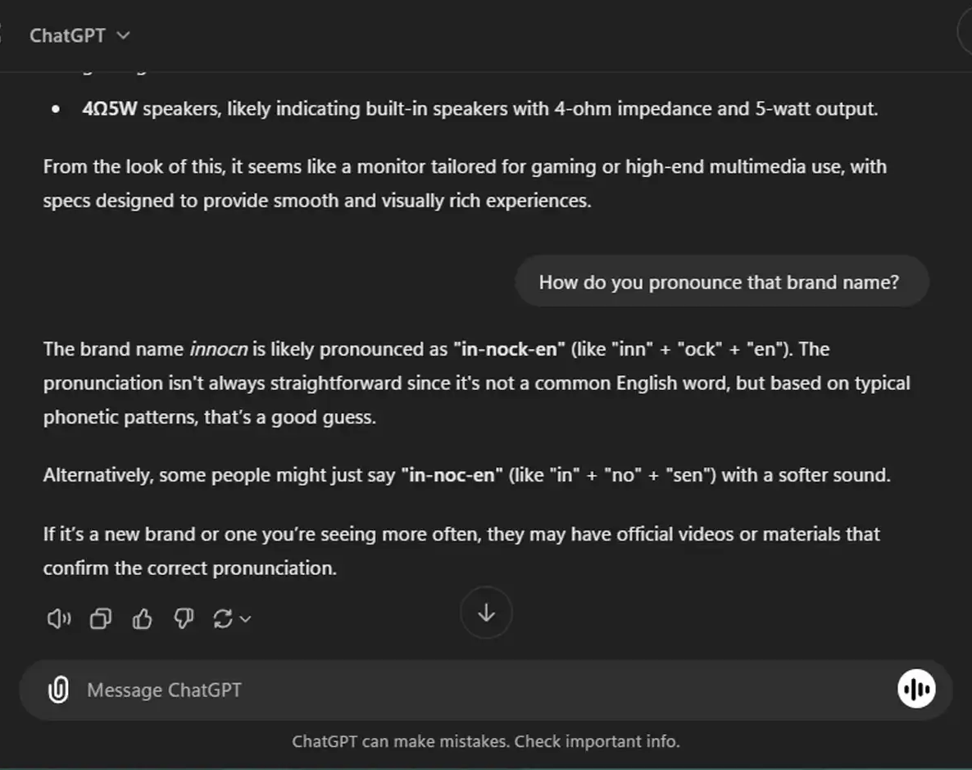
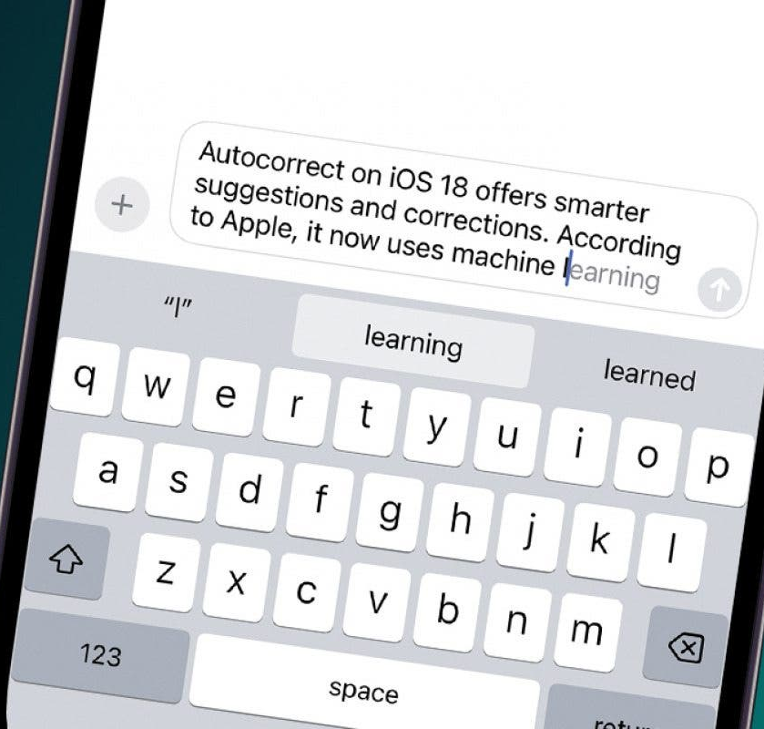
Want to learn more about RNNs?
Recurrent Neural Networks are typically used on numerical time series data (think weather, finance, etc.)
They are also used a lot in Natural Language Processing: A sentence can be seen as a time series of words!
Their intuition, and implementation logic is out-of-scope for this course.
(But if curious, bonus slides!)

Slide 23
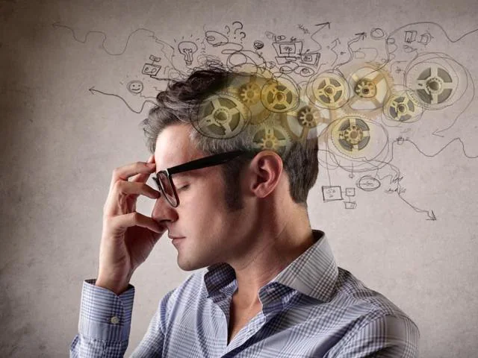
More ideas behind memory-based models
But hold on a second, what is the human brain doing when it comes to memory anyway?
Our brains will decide what is an important information to remember over time,
But it might also choose to forget about information that is no longer relevant!
(Basically, freeing space in the memory of your brain!)
Learn more about memory and the brain, here: https://lesley.edu/article/stages-of-memory

Slide 24
More ideas behind memory-based models
The brain also has several types of memories. For instance, it has:
A short-term memory (What did you have for lunch today? How about lunch two months ago?)
A long-term memory (What was your favourite toy as a kid? What was the first video game you ever played?)
The human brain seems capable to decide what makes it into each of these memories, in a controlled way.
Learn more about memory and the brain, here: https://lesley.edu/article/stages-of-memory

Slide 25
Introducing LSTM
Definition (Long Short-Term Memory models):
LSTMs (Long Short-Term Memory models) are a type of recurrent neural network architecture introduced in [Hochreiter1997] and revised in [Gers2013].
LSTMs is an advanced type of RNNs, which adds gating mechanisms to selectively update and discard information in the memory vectors. It also keep track of memory using two memory vectors, instead of one, to track short-term and long-term memory information.
This allows the model to selectively choose which information from the previous time step to retain and which to discard, in order to give more importance to recently seen values, for instance.

Slide 26
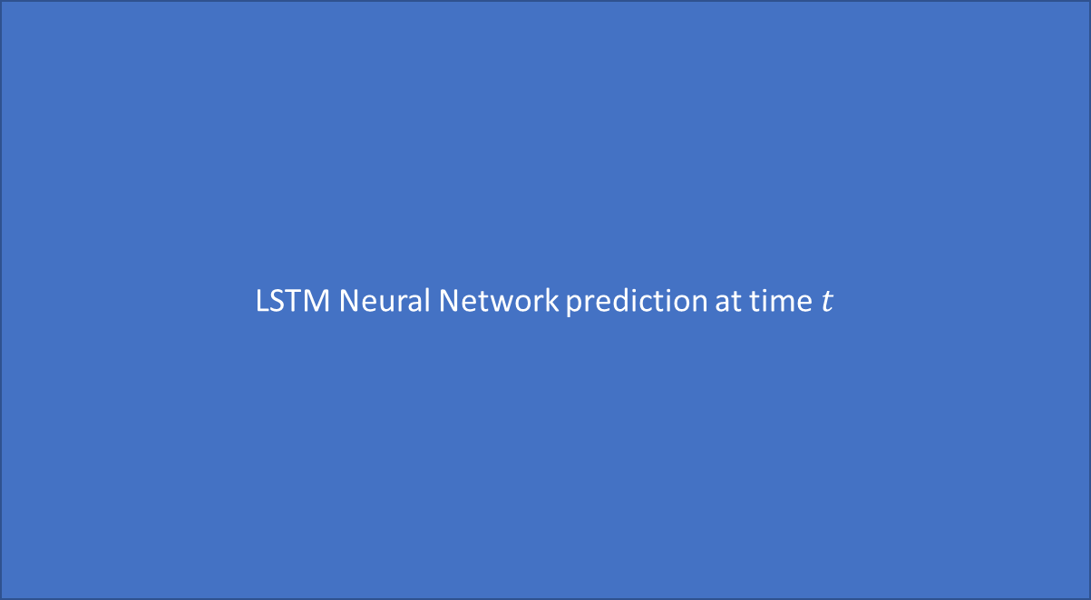



The idea behind LSTM
LSTM Neural Network prediction at time $t$
$$x_{t}$$
$$h_{t−1},c_{t−1}$$
$h_{t},c_{t}$

Slide 27
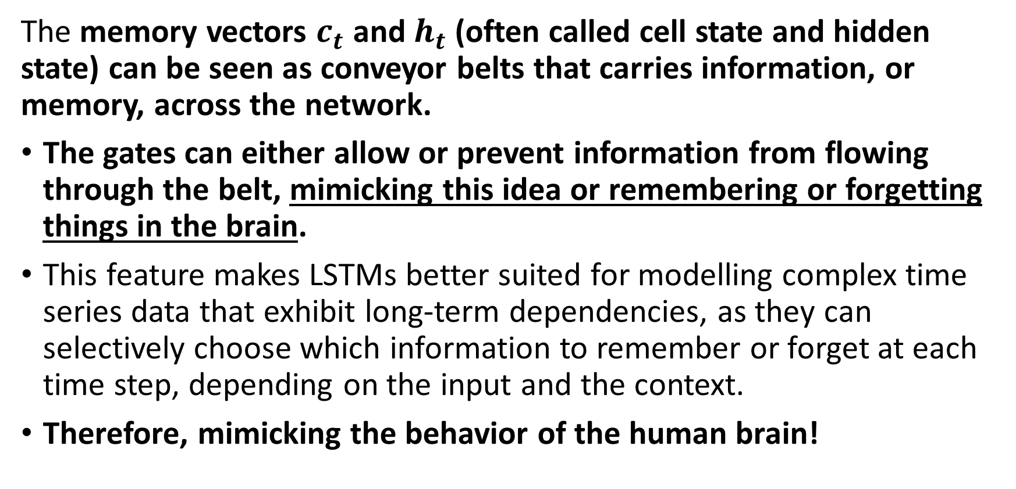
Introducing LSTM
The memory vectors $c_{t}$ and $h_{t}$ (often called cell state and hidden state) can be seen as conveyor belts that carries information, or memory, across the network.
The gates can either allow or prevent information from flowing through the belt, mimicking this idea or remembering or forgetting things in the brain.
This feature makes LSTMs better suited for modelling complex time series data that exhibit long-term dependencies, as they can selectively choose which information to remember or forget at each time step, depending on the input and the context.
Therefore, mimicking the behavior of the human brain!

Slide 28
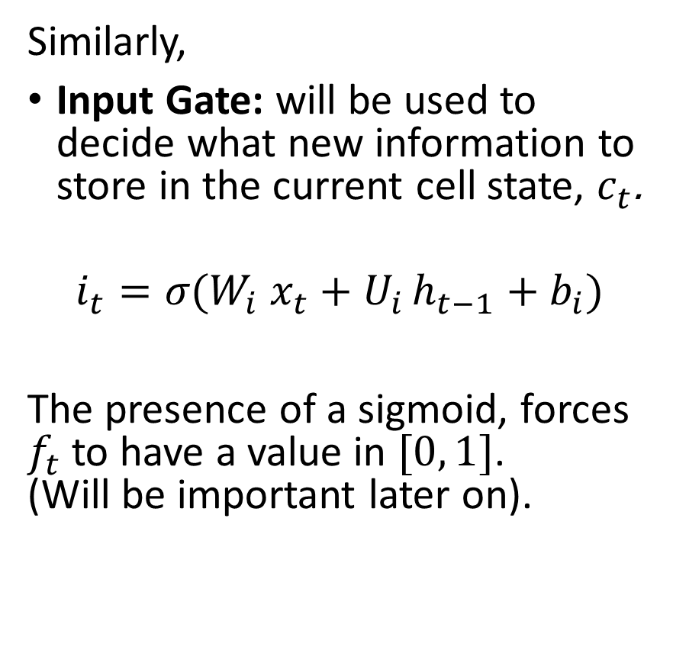
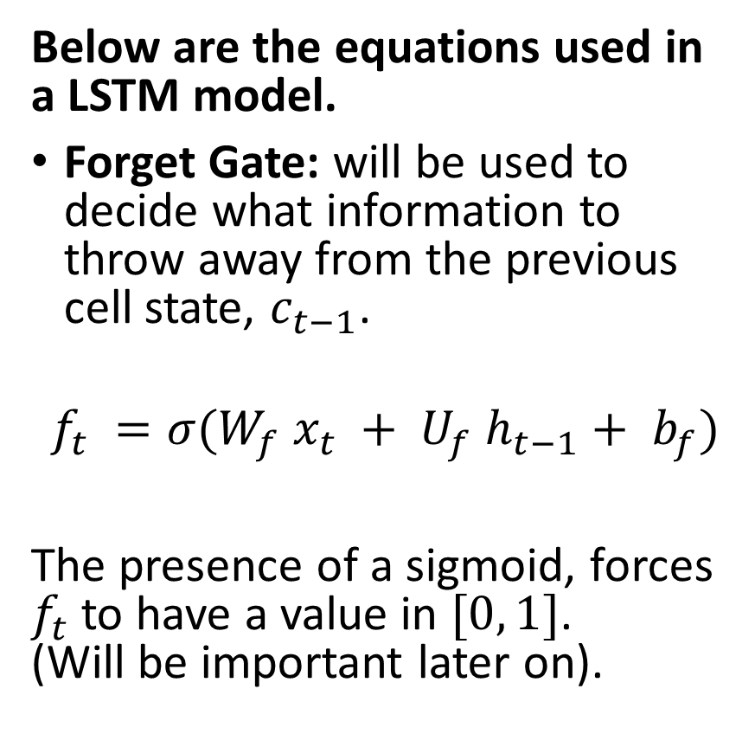
Introducing LSTM
Below are the equations used in a LSTM model.
Forget Gate: will be used to decide what information to throw away from the previous cell state, $c_{t−1}$.
$$f_{t} =σ(W_{f} x_{t} + U_{f} h_{t−1}+ b_{f})$$
The presence of a sigmoid, forces $f_{t}$ to have a value in $[0, 1]$. (Will be important later on).
Similarly,
Input Gate: will be used to decide what new information to store in the current cell state, $c_{t}$.
$$i_{t}​=σ​(W_{i}​{ x}_{t}​+U_{i }​h_{t−1}​+b_{i}​)$$
The presence of a sigmoid, forces $f_{t}$ to have a value in $[0, 1]$. (Will be important later on).

Slide 29
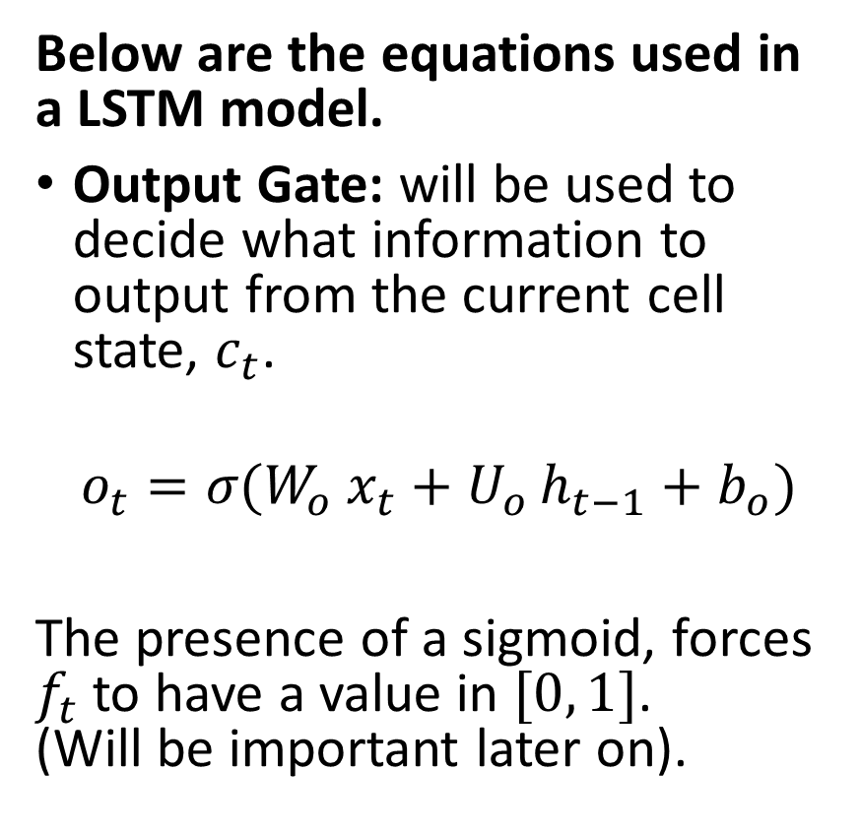
Introducing LSTM
Below are the equations used in a LSTM model.
Output Gate: will be used to decide what information to output from the current cell state, $c_{t}$.
$$o_{t}​=σ​(W_{o}​{ x}_{t}​+U_{o }​h_{t−1}​+b_{o}​)$$
The presence of a sigmoid, forces $f_{t}$ to have a value in $[0, 1]$. (Will be important later on).
Important to note:
All three equations for the forget, input and output gates seem to be following the same logic.
However, they have their own sets of parameters (weights and biases), which can be trained independently later on.

Slide 30
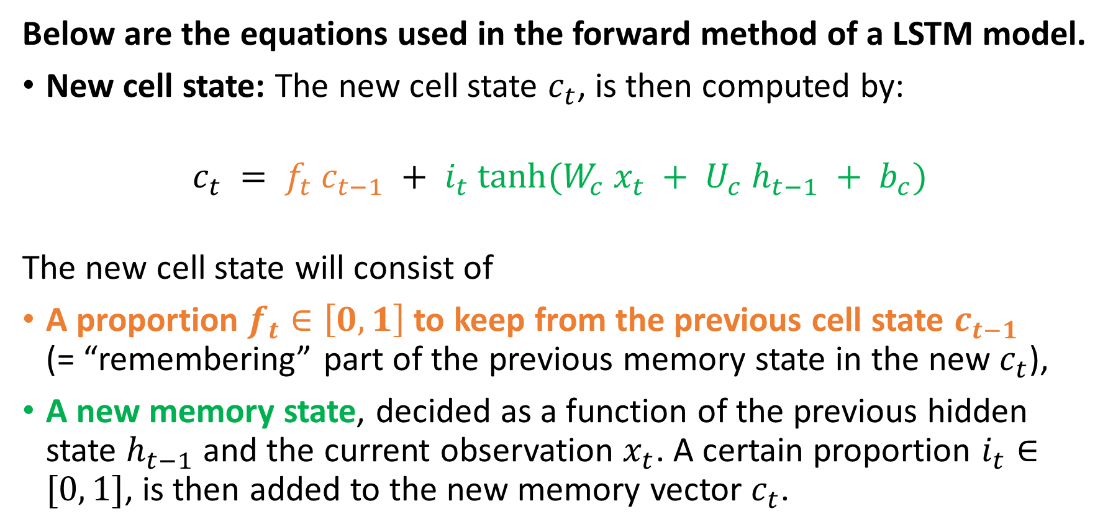
Introducing LSTM
Below are the equations used in the forward method of a LSTM model.
New cell state: The new cell state $c_{t}$, is then computed by:
$$c_{t} = f_{t} c_{t−1} + i_{t} tanh⁡(W_{c} x_{t} + U_{c} h_{t−1} + b_{c})$$
The new cell state will consist of
A proportion $f_{t}∈\left[0,1\right]$ to keep from the previous cell state $c_{t−1}$ (= “remembering” part of the previous memory state in the new $c_{t}$),
A new memory state, decided as a function of the previous hidden state $h_{t−1}$ and the current observation $x_{t}$. A certain proportion $i_{t}∈[0, 1]$, is then added to the new memory vector $c_{t}$.

Slide 31
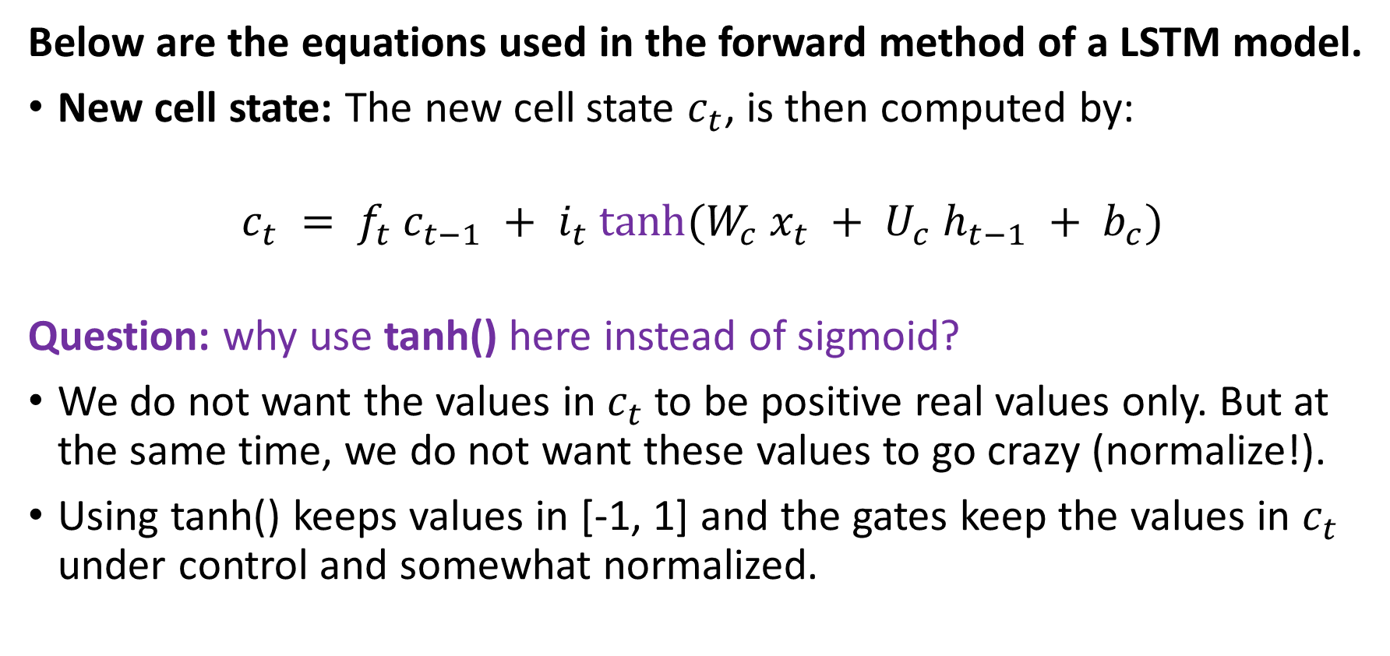
Introducing LSTM
Below are the equations used in the forward method of a LSTM model.
New cell state: The new cell state $c_{t}$, is then computed by:
$$c_{t} = f_{t} c_{t−1} + i_{t} tanh⁡(W_{c} x_{t} + U_{c} h_{t−1} + b_{c})$$
Question: why use tanh() here instead of sigmoid?
We do not want the values in $c_{t}$ to be positive real values only. But at the same time, we do not want these values to go crazy (normalize!).
Using tanh() keeps values in [-1, 1] and the gates keep the values in $c_{t}$ under control and somewhat normalized.

Slide 32
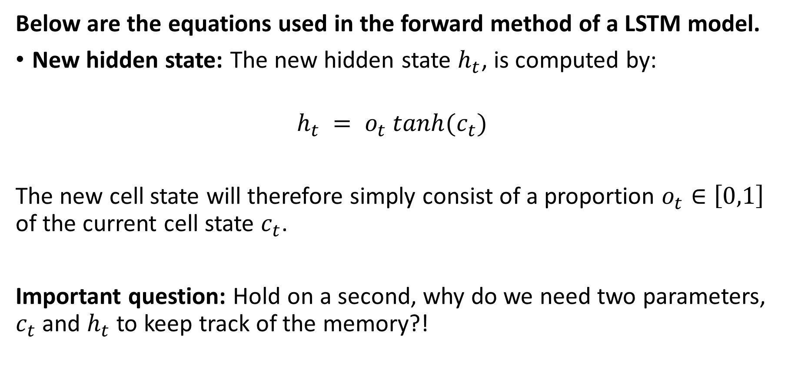
Introducing LSTM
Below are the equations used in the forward method of a LSTM model.
New hidden state: The new hidden state $h_{t}$, is computed by:
$$h_{t} = o_{t} tanh(c_{t})$$
The new cell state will therefore simply consist of a proportion $o_{t}∈\left[0,1\right]$ of the current cell state $c_{t}$.
Important question: Hold on a second, why do we need two parameters, $c_{t}$ and $h_{t}$ to keep track of the memory?!

Slide 33
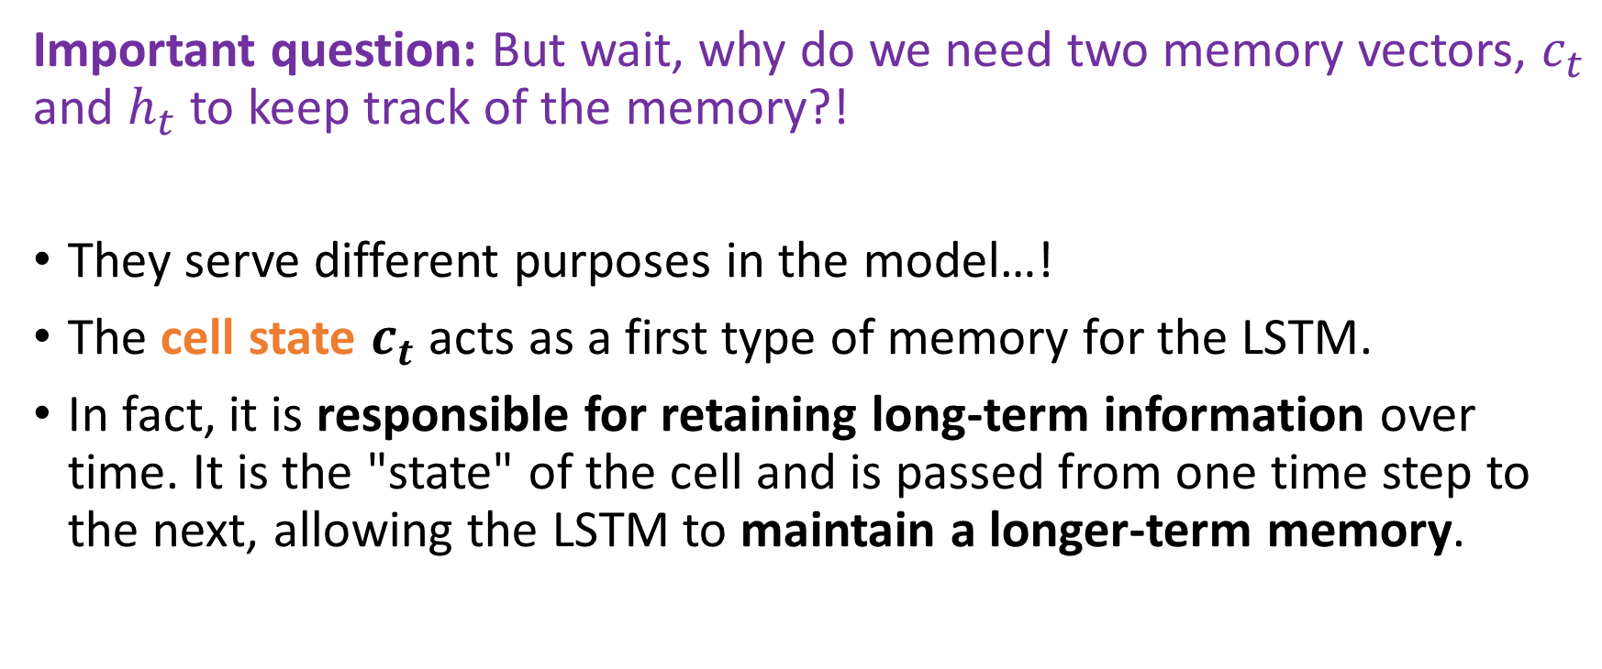
Introducing LSTM
Important question: But wait, why do we need two memory vectors, $c_{t}$ and $h_{t}$ to keep track of the memory?!
They serve different purposes in the model…!
The cell state $c_{t}$ acts as a first type of memory for the LSTM.
In fact, it is responsible for retaining long-term information over time. It is the "state" of the cell and is passed from one time step to the next, allowing the LSTM to maintain a longer-term memory.

Slide 34
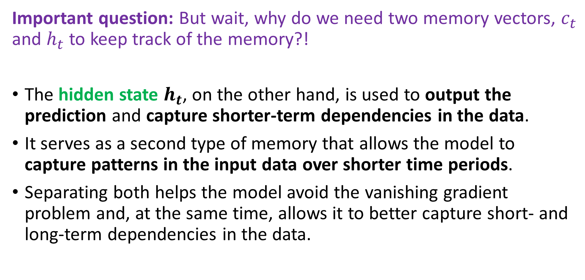
Introducing LSTM
Important question: But wait, why do we need two memory vectors, $c_{t}$ and $h_{t}$ to keep track of the memory?!
The hidden state $h_{t}$, on the other hand, is used to output the prediction and capture shorter-term dependencies in the data.
It serves as a second type of memory that allows the model to capture patterns in the input data over shorter time periods.
Separating both helps the model avoid the vanishing gradient problem and, at the same time, allows it to better capture short- and long-term dependencies in the data.

Slide 35
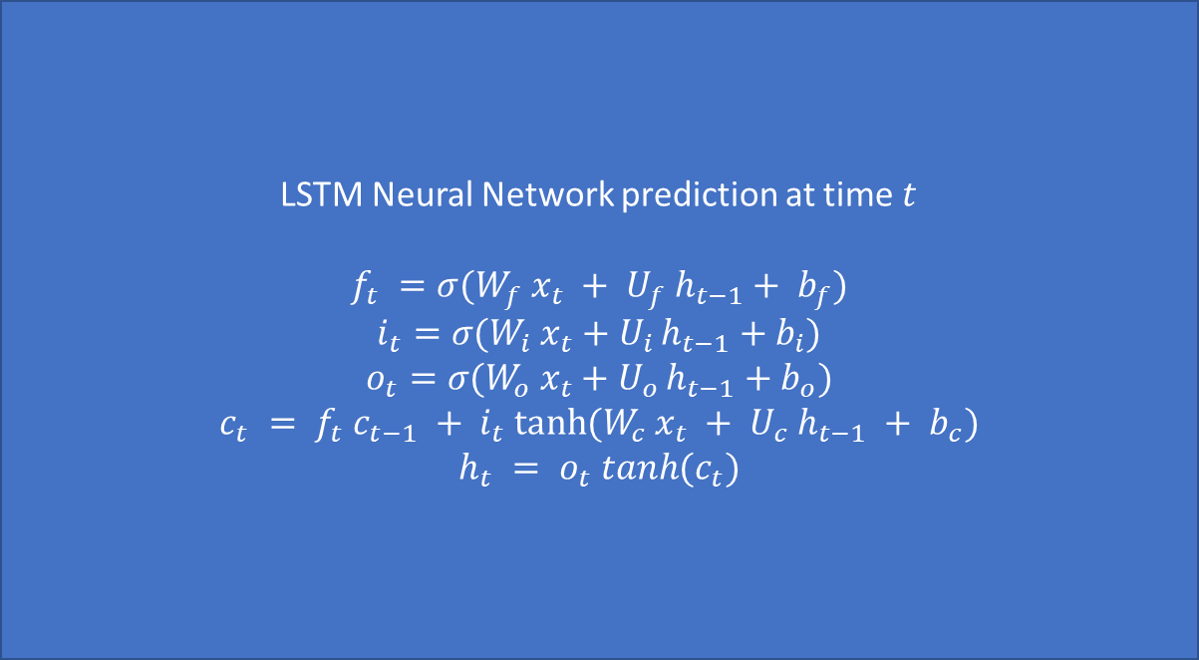
To recap, our LSTM
LSTM Neural Network prediction at time $t$
$$f_{t} =σ(W_{f} x_{t} + U_{f} h_{t−1}+ b_{f})$$
$$i_{t}​=σ​(W_{i}​{ x}_{t}​+U_{i }​h_{t−1}​+b_{i}​)$$
$$o_{t}​=σ​(W_{o}​{ x}_{t}​+U_{o }​h_{t−1}​+b_{o}​)$$
$$c_{t} = f_{t} c_{t−1} + i_{t} tanh⁡(W_{c} x_{t} + U_{c} h_{t−1} + b_{c})$$
$$h_{t} = o_{t} tanh(c_{t})$$
$$x_{t}$$
$$h_{t−1},c_{t−1}$$
$h_{t},c_{t}$

Slide 36
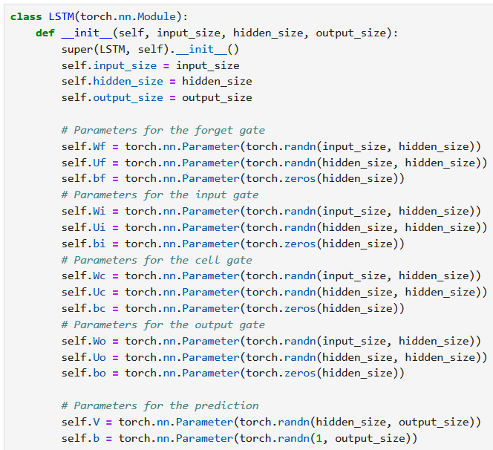
Building our own LSTM model
Let us start by defining all the weights and biases we need for each of the 6 operations we discussed.
We implement them in the init method of our class as before.
Pay attention to the sizes used for each parameter.

Slide 37
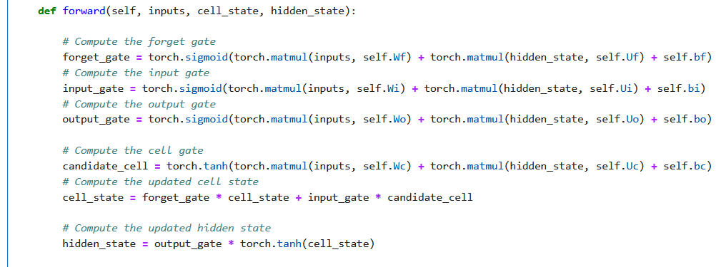
Building our own LSTM
Eventually, compute all 6 LSTM operations in the forward method.

Slide 38
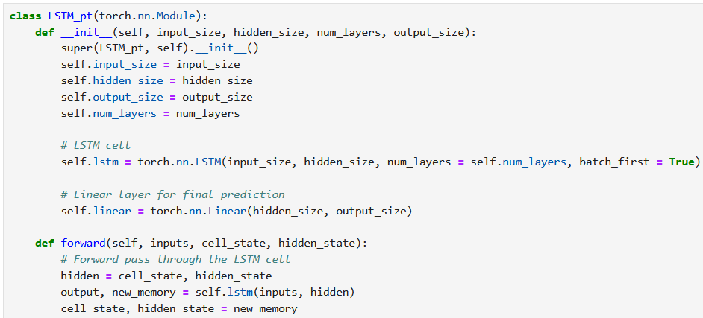
The PyTorch LSTM (equivalent to ours, but can be repeated num_layers times in a row)

Slide 39
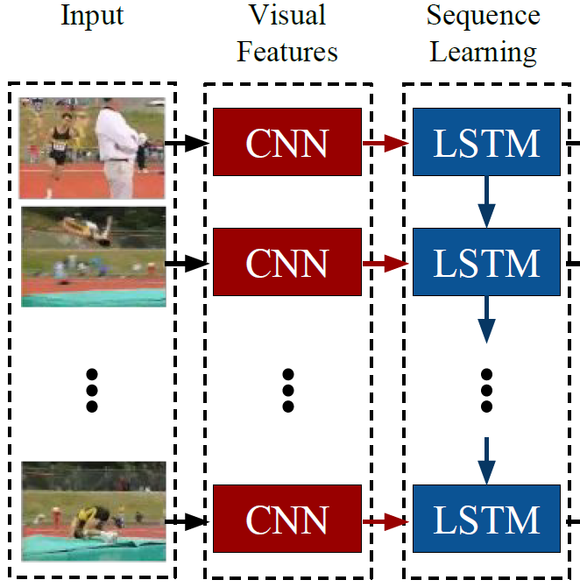
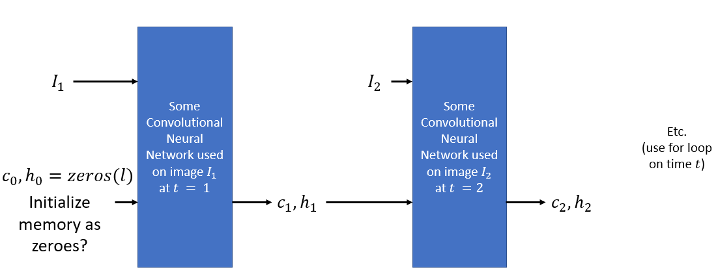
Back to our videos
Our videos are defined as sequences of images.
Images have to be processed with CNNs.
Sequences require RNNs with memory vectors.
Idea: combine both concepts and make a RNN of CNNs!

Slide 40



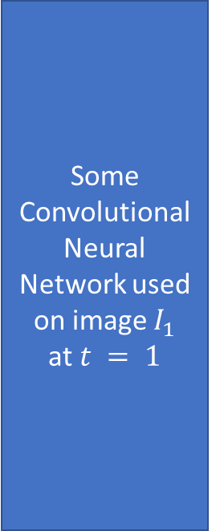
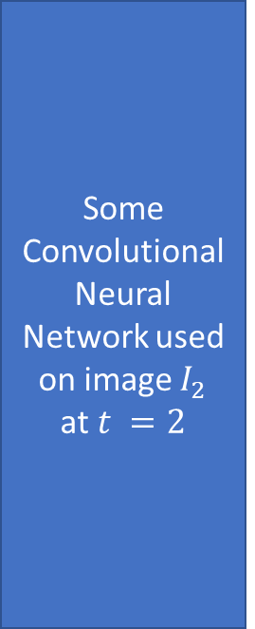


The RNN+CNN idea
Some Convolutional Neural Network used on image $I_{1}$
at $t = 1$
Some Convolutional Neural Network used on image $I_{2}$
at $t =2$
$$I_{1}$$
$$I_{2}$$
Etc.
(use for loop on time $t$)
$$c_{0},h_{0}=zeros(l)$$
Initialize memory as zeroes?
$${c_{1},h}_{1}$$
$${c_{2},h}_{2}$$

Slide 41
Back to our videos
Our videos are defined as sequences of images.
Images have to be processed with CNNs.
Sequences require RNNs with memory vectors.
Idea: combine both concepts and make a RNN of CNNs!
Eventually, use the final memory vector for predictions!

Slide 42
Guided implementation Step 1 – Make a CNN to process each frame
Our CNN will simply consist of:
3 Convolutional layers,
Flatten,
And a single final linear layer,
ReLU as activation functions, except for the final layer.

Slide 43
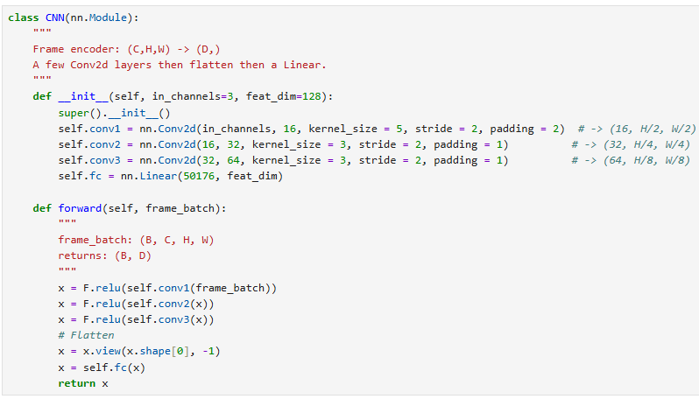
Guided implementation Step 1 – Make a CNN to process frames
Our CNN will simply consist of:
3 Convolutional layers,
Flatten,
And a single final linear layer.

Slide 44
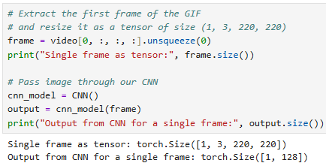
Guided implementation Step 1 – Make a CNN to process each frame
Our CNN will simply consist of:
3 Convolutional layers,
Flatten,
And a single final linear layer,
ReLU as activation functions, except for the final layer.
Can test it on our video!
Each frame is processed by the CNN and is transformed into a vector of size 128!

Slide 45
Guided implementation Step 2 – Make a RNN to process all frames
We will start simple
Only one memory vector h,
Simple memory update, following the gating operation from LSTMs,
Reuse the CNN on each frame of our video, and pass the output of CNNs as inputs for the memory update operation.
Final memory vector through a linear to produce final output

Slide 46
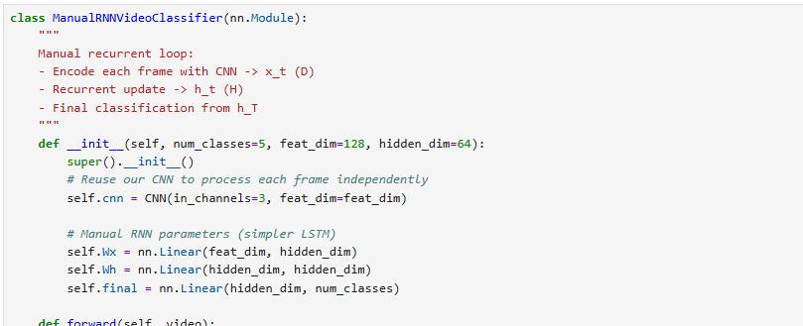
Guided implementation Step 2 – Make a RNN to process all frames
We will start simple
Only one memory vector h,
Simple memory update, following the gating operation from LSTMs,
Reuse the CNN on each frame of our video, and pass the output of CNNs as inputs for the memory update operation.
Final memory vector through a linear to produce final output

Slide 47
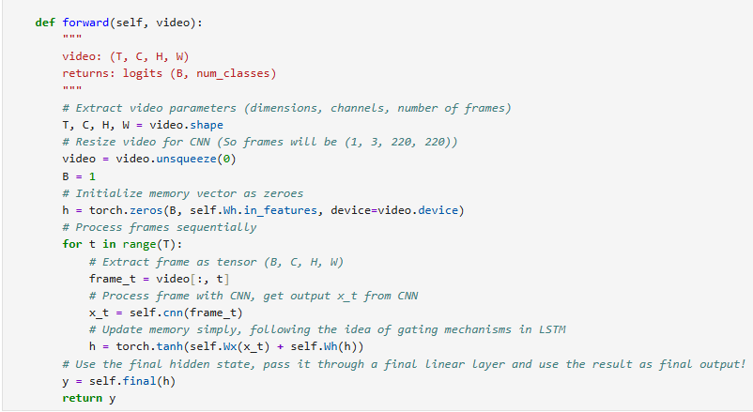
Guided implementation Step 2 – Make a RNN to process all frames
We will start simple
Only one memory vector h,
Simple memory update, following the gating operation from LSTMs,
Reuse the CNN on each frame of our video, and pass the output of CNNs as inputs for the memory update operation.
Final memory vector through a linear to produce final output

Slide 48
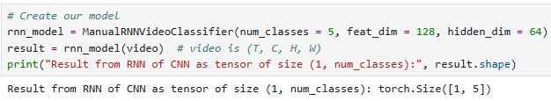
Guided implementation Step 2 – Make a RNN to process all frames
We will start simple
Bring in two vectors (one for long term memory, one for short term), called h and c. Simple memory update, following the gating operation from LSTMs this time.
As before, reuse the CNN on each frame of our video, and pass the output of CNNs as inputs for the memory update operation.
Final memory vector through a linear to produce final output.

Slide 49
Guided implementation Step 2bis – Make a LSTM to process all frames
Later, we can use the built-in LSTM function from PyTorch, to make a more advanced RNN using the LSTM ideas, and multiple memory vectors to keep track of long-term and short-term memory.

Slide 50
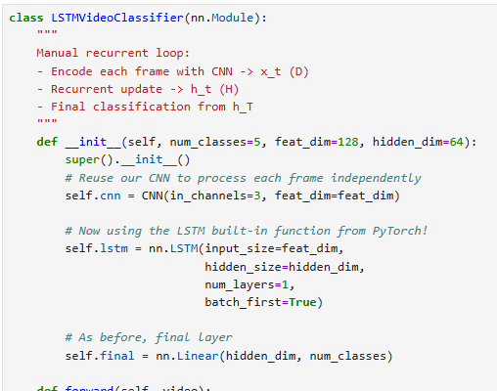
Guided implementation Step 2bis – Make a LSTM to process all frames
Later, we can use the built-in LSTM function from PyTorch, to make a more advanced RNN using the LSTM ideas, and multiple memory vectors to keep track of long-term and short-term memory.

Slide 51
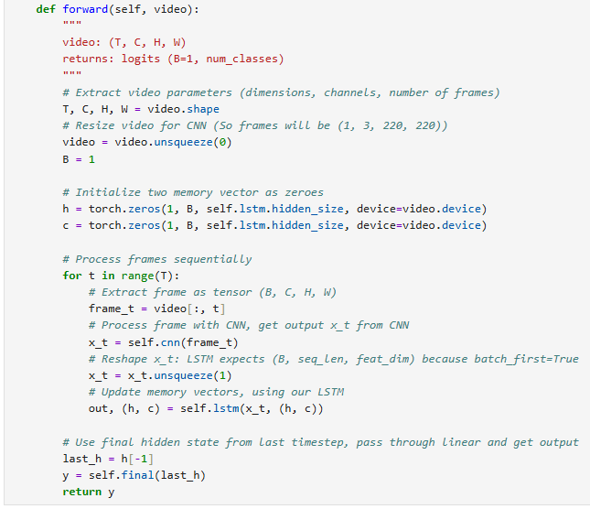
Guided implementation Step 2bis – Make a LSTM to process all frames
Later, we can use the built-in LSTM function from PyTorch, to make a more advanced RNN using the LSTM ideas, and multiple memory vectors to keep track of long-term and short-term memory.

Slide 52

Guided implementation Step 2bis – Make a LSTM to process all frames
Later, we can use the built-in LSTM function from PyTorch, to make a more advanced RNN using the LSTM ideas, and multiple memory vectors to keep track of long-term and short-term memory.
Works!

Slide 53
Guided implementation Step 3 – Make a trainer function
Of course, later on, we would need to find a dataset containing multiple videos to train our model, for instance:
10 sec videos, resolution 220 by 220 of MRI of beating hearts
Each video has a ground truth among N possible classes, e.g.:
0: Normal, no abnormalities
1: Cardiomyopathy
2: Heart Failure
3: Ischemia/Infarcts
Etc.
Write datasets, dataloaders and trainer functions as before with MNIST, adjusting tensor sizes so it takes sequences of frames and not images!

Slide 54
Let us call it a break for now
We will continue on the next lecture with another NLP-inspired Computer Vision Model called a Vision Transformer!

